Slide 1

Customer Shopping Behavior Analysis
Uncovering insights from transactional data to drive strategic business decisions.

Slide 2

Project Overview & Dataset Summary
Project Goal
Dataset Details
Analyze 3,900 purchases to understand spending patterns, segments, product preferences, and subscription behavior.
3,900 Rows, 18 Columns
Key Features: Demographics, Purchase Details, Shopping Behavior
Missing Data: 37 values in Review Rating

Slide 3
Exploratory Data Analysis (Python)
01
02
03
Data Loading & Initial Exploration
Missing Data Handling
Column Standardization
Imputed Review Rating using median by product category.
Renamed columns to snake_case for readability.
Imported with pandas, checked structure and summary statistics.
04
05
Feature Engineering
Data Consistency & Integration
Created age_group and purchase_frequency_days.
Dropped redundant promo_code_used, loaded to PostgreSQL.

Slide 4
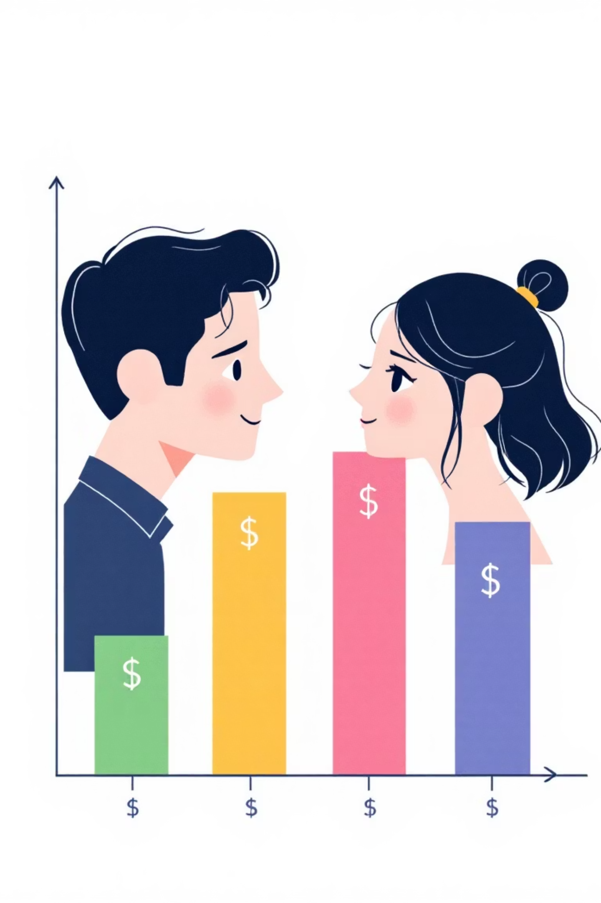
Data Analysis (SQL) - Key Insights
Revenue by Gender
High-Spending Discount Users
Male: $157,890
Identified 839 customers.
Female: $75,191

Slide 5

Top Products & Shipping Preferences
Top 5 Products by Rating
Shipping Type Comparison
Gloves (3.86)
Sandals (3.84)
Boots (3.82)
Hat (3.80)
Skirt (3.78)
Express: $60.48 avg.
Standard: $58.46 avg.

Slide 6
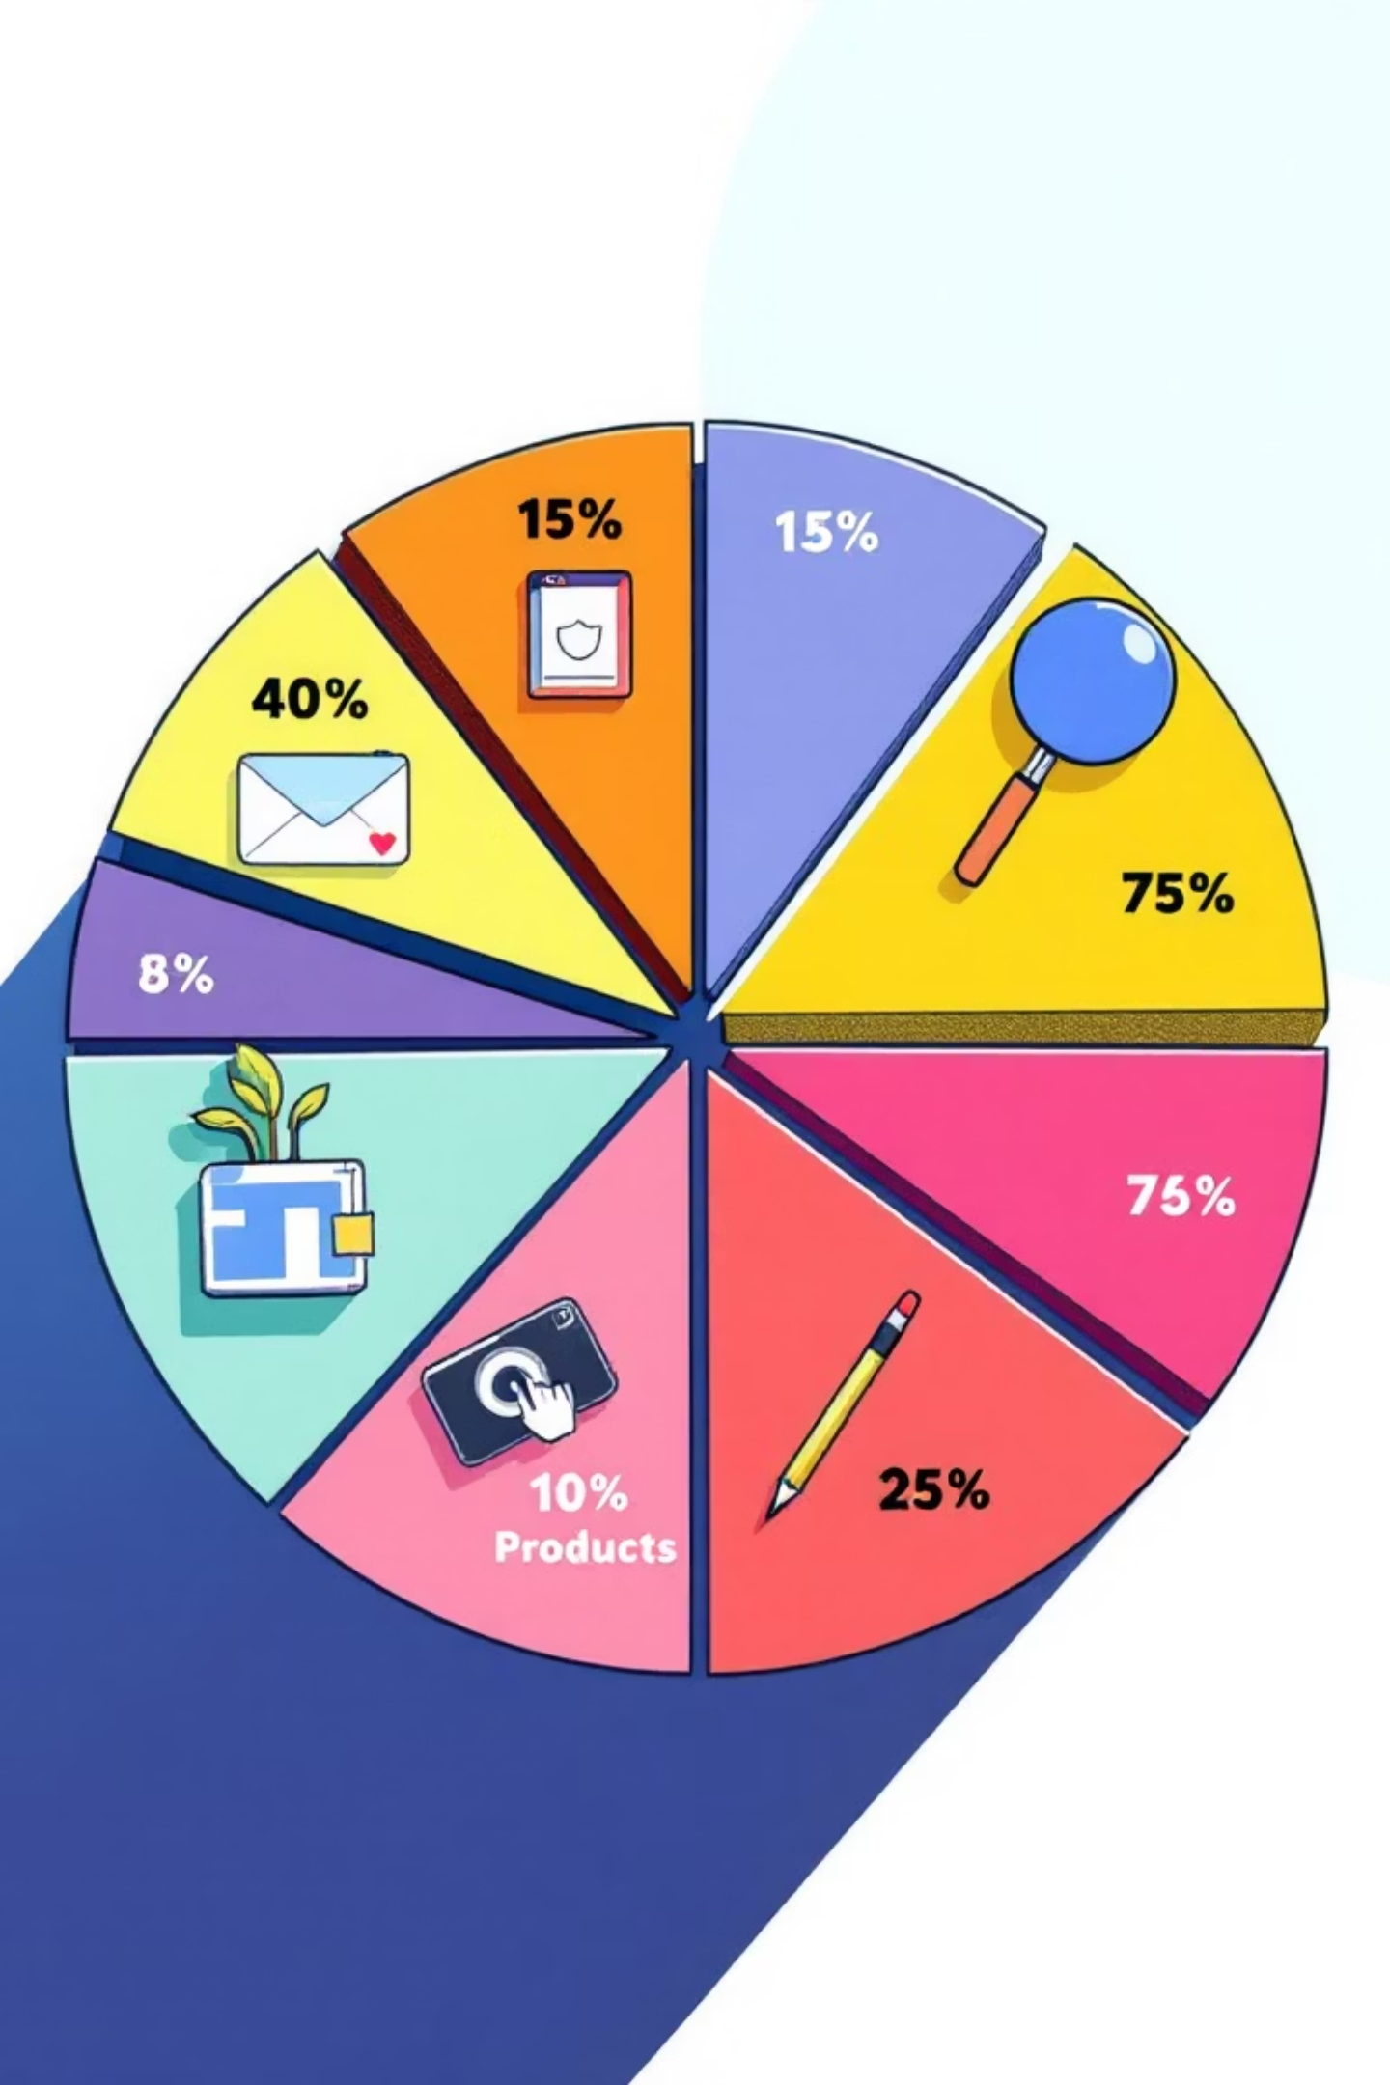
Subscription & Discount Behavior
Subscribers vs. Non-Subscribers
Discount-Dependent Products
Subscribers: 1,053 customers, $59.49 avg. spend
Non-Subscribers: 2,847 customers, $59.87 avg. spend
Hat (50%)
Sneakers (49.66%)
Coat (49.07%)

Slide 7

Customer Segmentation & Age Group Revenue
Customer Segments
Revenue by Age Group
Loyal: 3,116
Returning: 701
New: 83
Young Adult: $62,143
Middle-aged: $59,197
Adult: $55,978
Senior: $55,763

Slide 8

Top Products by Category
Accessories
1
Jewelry
Sunglasses
Belt
Clothing
2
Blouse
Pants
Shirt
Footwear
3
Sandals
Shoes
Sneakers
Outerwear
4
Jacket
Coat

Slide 9
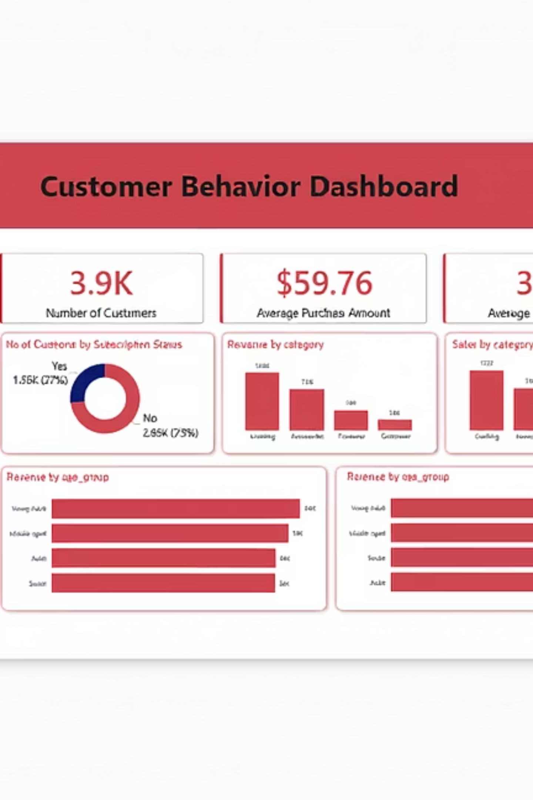
Power BI Dashboard: Visualizing Insights
Interactive dashboard presenting key metrics and trends at a glance.

Slide 10





Business Recommendations
Boost Subscriptions
Promote exclusive benefits.
Customer Loyalty
Reward repeat buyers.
Review Discount Policy
Balance sales with margin.
Targeted Marketing
Focus on high-revenue groups.

